Slide 1
Spartan Cars
Submitted to : Prof. Gopinath Vinodh
Submitted by : Dhanasree Are Srihari Duvvuri
Vamsi Krishna Chakravarthula Vishal Gadapa

Slide 2
Agile Process
Scrum Meetings
One team meeting every week
Progress discussed
Issues raised
Kanban Progress Tracker
To maintain user stories
Track progress and completion of stories
Weekly Task Sheet updates
Bi-weekly Sprint Sheet updates

Slide 3
XP Core Values
Communication
Frequent collaboration
Feedback
Update the team about the progress in every meeting

Slide 4






Tech Stack
Load Balancer

Slide 5
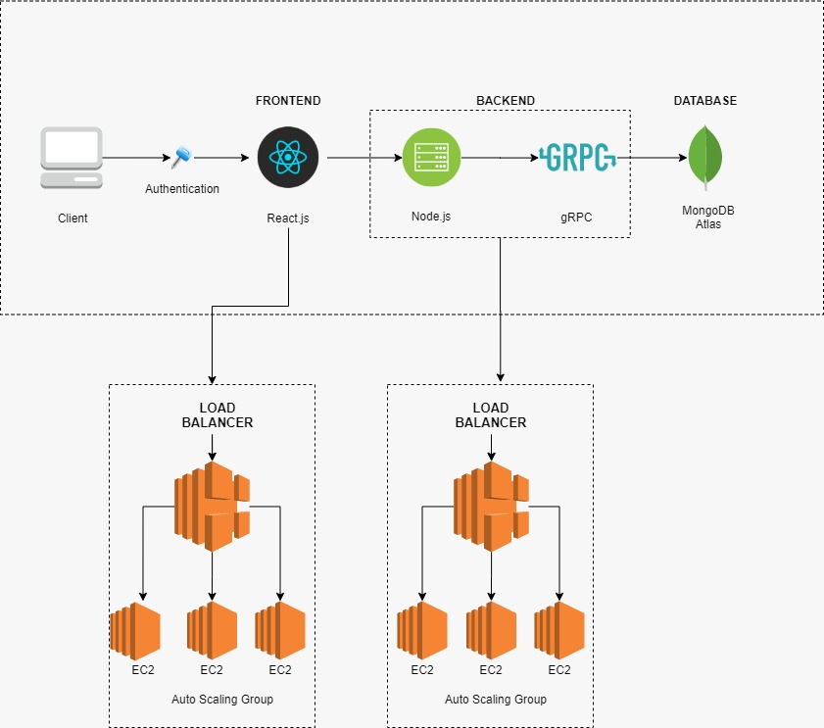
Project Architecture

Slide 6
Let’s begin with the demo…

Slide 7
Thank you!

